Slide 1
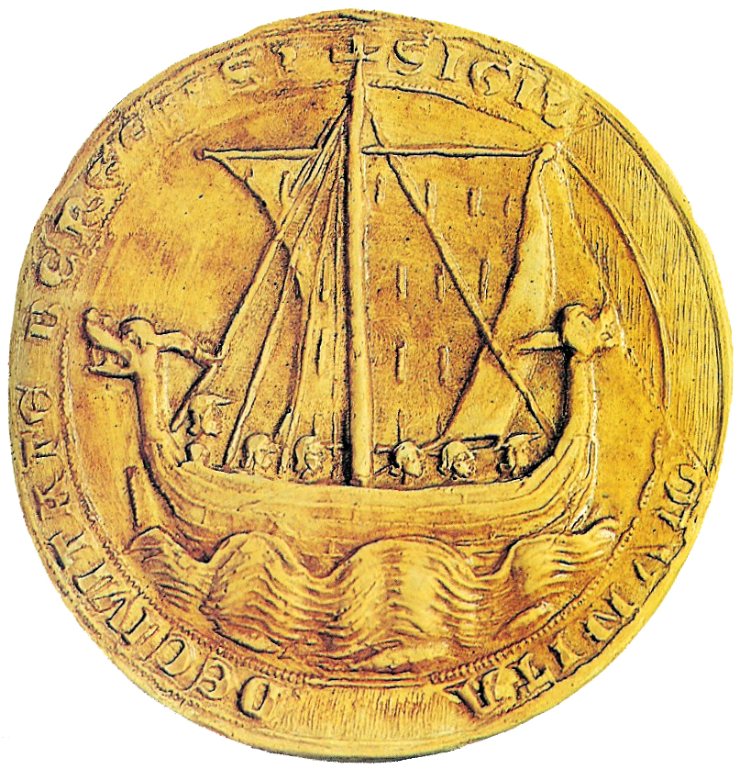
The Anglo-Saxons: 449–1066
The Anglo-Saxon Period 449-1066

Slide 2
Anglo-Saxon Period
“Anglo-Saxon England was born of warfare, remained forever a military society, and came to its end in battle.” - J. R. Lander
In a society dominated by aggression, what would you expect to be the Anglo-Saxon attitude toward family life, the role of women, art, literature, ethics and work?

Slide 3
The Anglo-Saxons: 449–1066
A.D. 449
Anglo-Saxon Invasion
A.D. 1066
Norman Invasion
300s B.C.
Celts in Britain
A.D.878
King Alfred against
the Danes
55 B.C–A.D.409
Roman Occupation
300 B.C.
A.D.
1
A.D.
300
A.D.
600
A.D.
900
A.D.
1200
A.D. 400–699
Spread of Christianity

Slide 4
Celtic Invasions
Around 500 BC two groups of Celts invaded British Isles
Brythons (Britons) settled island of Britain
Gaels settled on Ireland
Picts settled in Scotland
Organized into clans; loyal to chieftain
Religion – animism (from Latin for “spirit”)
Believed spirits controlled every aspect of life
Druids – priests who settled arguments, presided over religious
rituals, and memorized and recited poems about past
Conquered by Romans in the first century A.D. and became part of the Roman Empire.
Druids thought that the soul was immortal, passing in death from death from one person to another. Considered mistletoe and oak trees sacred and generally held their rites in old oak forests.
Notes:
From about 700 B.C., the Celts dominated most of what is now western and central Europe. Skilled artisans, they introduced the use of iron to the rest of Europe. They also had a highly developed religion, mythology, and legal system that specified individual rights. The Celts were also adept at curing hams, keeping bees, and making wooden barrels. The language of the Celts was dominant in Britain until around the 5th.

Slide 5
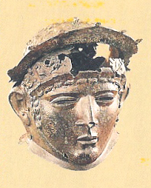
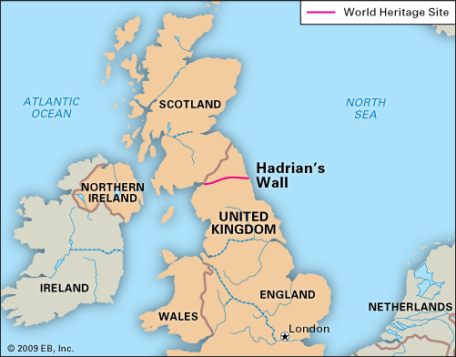
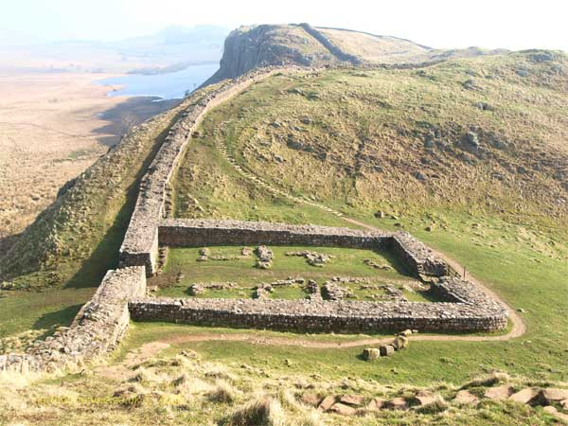
Roman Invasions
55 BC Julius Caesar invaded Britain
43 AD Emperor Claudius invaded; marks beginning of Roman Britain
Began to Christianize the Celts; Celtic religion vanished
Controlled world from Hadrian’s Wall to Arabia
Roman Helmet
Notes:
Refer to British Isles map in contents pages
The great defensive wall is Hadrian's Wall, which linked the North Sea and the Atlantic near the present-day border between England and Scotland, and held back the marauding Picts and Scots for two hundred years. Along this wall were seventeen large stone forts to house the Roman legions guarding the frontier.

Slide 6
Roman Invasions: What legacy did the Romans leave?
System of roads/highways – height of the empire, one could travel on post roads and use same currency from Northumbria to Middle East; not possible since
Provided an organized society which kept other invaders out for several centuries
410 Rome threatened and Romans pulled out of Britain
Notes:
The 5,000 miles of stone roads the Romans built linked tribal capitals and towns, especially London, York, and Winchester. These roads faciliated trade, the collection of taxes, and the movement of troops.
With the Romans gone and no central government in place, how did this leave the Britains? Vulnerable to outside attacks? Clans fighting for control?

Slide 7
Germanic Invasions - 449
Angles/Saxons from Germany
Jutes from Denmark
Angles, Saxons, and Jutes
Deep sea fishermen and farmers
Britons no match, but didn’t go quietly
Pushed west to Wales
King Arthur was probably a Celtic chieftain named Arturius
Language
Common language now known as Old
English (similar to Dutch and German)
Religion – pagan – similar to Norse mythology
Notes:
What are some of the names of Anglo-Saxon gods that has survived and still very much part of our daily lives?
Tuesday – from Tiw
Wednesday from Woden
Thursday – chief Teutonic god – Thor – god of thunder
Friday – from Frigga, goddess of the home

Slide 8
The Anglo-Saxon Invasion
Jutes
Angles
Celts
Saxons
A.D. 449 The Anglo-Saxons push the Celts into the far west of the country.

Slide 9
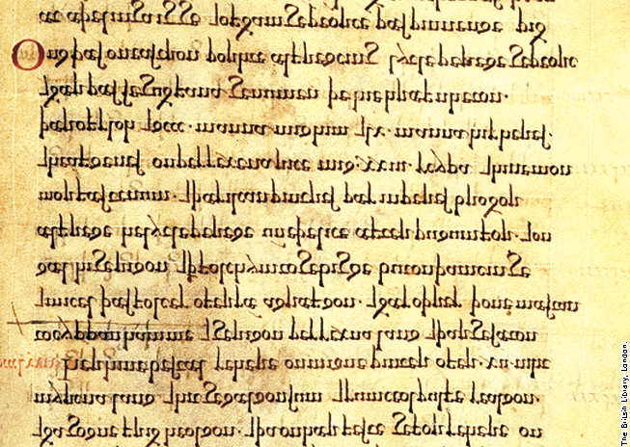
The Anglo-Saxon Invasion
Page from Anglo-Saxon Chronicle
Old English

Slide 10
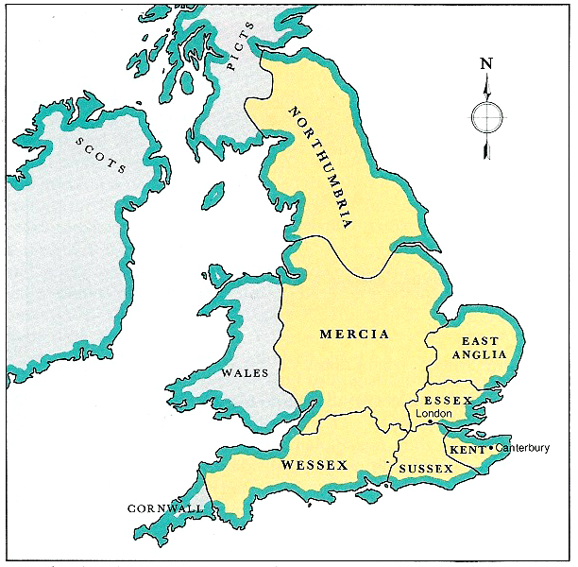
Germanic Invasions - 449
Created the Anglo-Saxon England (“Engla land”) that lasted until 1066
Divided into separate kingdoms: Kent, Northumbria, Mercia and Wessex most important
United themselves in last two centuries to resist invasions from Vikings, or Norsemen (whom they called Danes).
Seven kingdoms of Anglo-Saxon Period: Northumbria, Mercia, Wessex, East Anglia, Essex, Sussex, and Kent

Slide 11
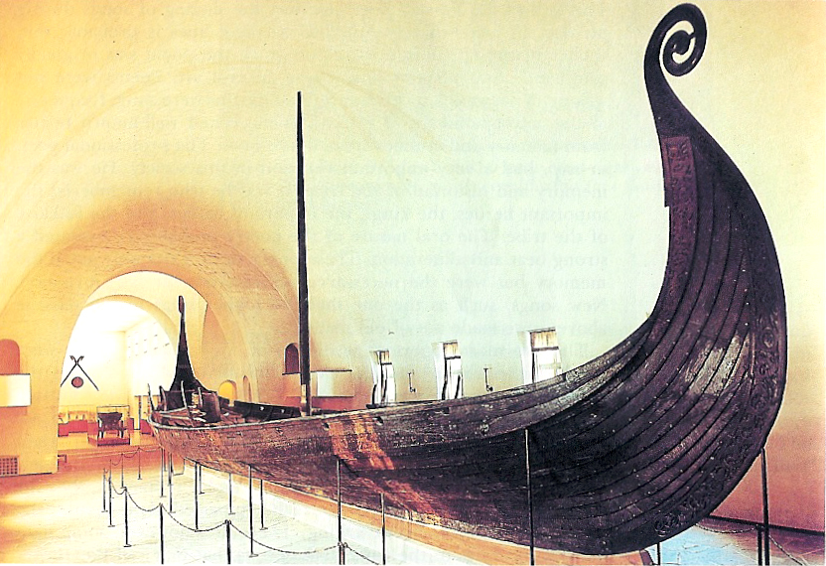
Viking Invasions 8th-12th Centuries
Invaders from Norway and Denmark
Anglo-Saxons unprepared for ferocity of Vikings
Common prayer: “From the furor of the Norsemen, Oh Lord protect us.”
Viking Ship, known as the Oseberg Ship, dates 825 AD.
Notes:
Viking Ship, known as the Oseberg Ship, dates 825 AD, and is thought to be the burial chamber of Asa, a Viking queen, whose active life belied the passive role women played at this time in history. Married against her will to a Norwegian king, Asa had her husband killed and ruled alone until her death in 850. Accompanying Asa on her voyage to the afterlife was the body of a maidservant, priceless gold and gems (which subsequently were stolen by looters), and objects such as sleds and a wagon. These would permit Asa to travel in the afterlife as much as the Vikings enjoyed traveling while living.
Not a true longboat, this royal barge was tied to a rock before it was buried.
The ship was unearthed in 1904.

Slide 12
Viking Invasions 8th-12th Centuries
Vikings destroyed monasteries and sacred objects
Slaughtered everyone in settlements that couldn’t pay enough to them
King Alfred of Wessex (871-899) forced Vikings to northern England
Danelaw – dividing line between Viking Britain and Anglo-Saxon Britain

Slide 13
Anglo-Saxon Literature
Oral tradition – poems and song committed to memory and performed by scops, bards, gleemen, or minstrels
With coming of Christian Church, written literature began to evolve
Two important traditions in literature
heroic tradition – celebrates heroes
elegiac tradition – passing of earlier, better
times
***Why were scops so important?
The Anglo-Saxons didn’t believe in afterlife
Warriors gained immortality through songs

Slide 14
Anglo-Saxon Civilization
Common language
Shared a heroic ideal; set of traditional heroes
Admired men of outstanding courage
Loyalty to leader and tribe
Fierce personal valor

Slide 15
Anglo-Saxon Civilization
Persons of rank received with grave courtesy
Ruler generous to those who remain loyal
Everyone aware of shortness of life & passing of all things in the world
Impersonal, irresistible fate determined most of life (Wyrd or Fate)
Heroic human will & courage allowed individuals to control their own response to fate
Notes:
As a result, they would win fame and become models for others?
What does the word stoic mean?
How do you think stoicism will play into literature?

Slide 16
Anglo-Saxon Literature
Beowulf – one of few pieces that survived. Priests and monks were the only ones who could write; stories survival depended upon them. The church was not too eager to preserve literature that was pagan in nature, so historians believe they either ignored it or changed it. This may account for the mixture of Christian and pagan elements in Beowulf.

Slide 17
Why Study Beowulf?
1. Beowulf is the oldest poem in the English language, so everything written since Beowulf stems from it in some way
2. The story of Beowulf encompasses common themes that we still see in English literature today
3. Beowulf is simply good writing…

Slide 18
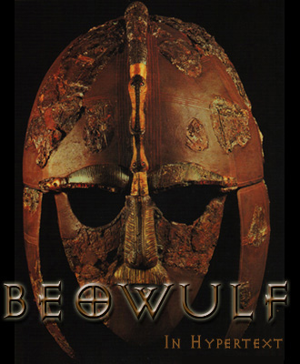
Anglo-Saxon Literature
Beowulf: England:: Iliad and Odyssey : Greece
Oral art – handed down with changes and embellishments
Composed in Old English probably in Northumbria in northeast England sometime between 700-750
Depicts a world from the early 6th century

Slide 19
Anglo-Saxon Literature
Poem based on early Celtic and Scandinavian folk legends
Scenery described is from Northumbria; assumed that poet was Northumbrian monk
Only manuscript available dates from the year 1000; discovered in the 18th century

Slide 20
More about Beowulf
Epic poem, written between 700 and 750
Beowulf is the epic hero
Is believed to be written by monks because of the religious references

Slide 21
Beowulf’s Provenance
What we don’t know:
who wrote it
when exactly it was written
how much, exactly, is based on historical truth

Slide 22
Beowulf’s Provenance
What we do know:
Beowulf is the oldest surviving English poem. It’s written in Old English (or Anglo-Saxon), which is the basis for the language we speak today.
Some of the characters in the poem actually existed.
The only copy of the manuscript was written sometime around the 11th century A.D. (1000’s)…

Slide 23
Beowulf’s Provenance
So why wasn’t it written down in the first place?
This story was probably passed down orally for centuries before it was first written down.
It wasn’t until after the Norman Invasion (1066) that writing stories down became common in this part of the world.

Slide 24
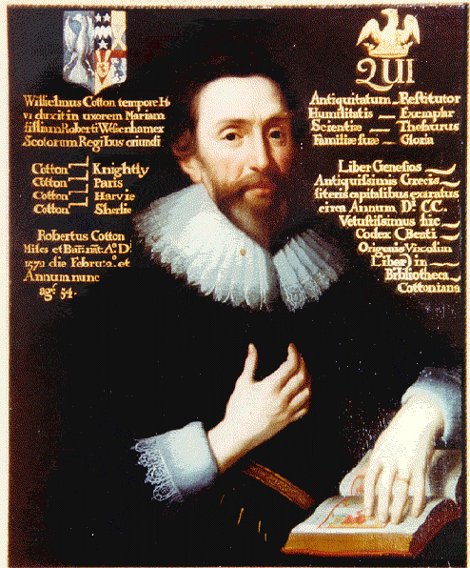
Beowulf’s Provenance
So what’s happened to the manuscript since the 11th century?
Eventually, it ended up in the library of this guy.
Robert Cotton (1571-1631)

Slide 25
Beowulf’s Provenance
Unfortunately, Cotton’s library burned in 1731. Many manuscripts were entirely destroyed. Beowulf was partially damaged.
The manuscript is now preserved and carefully cared for in the British Museum.

Slide 26
Characteristics of Epic Hero
Is significant and glorified
Is on a quest
Has superior or superhuman strength, intelligence, and/or courage
Is ethical
Risks death for glory or for the greater good of society
Performs brave deeds
Is a strong, great and responsible leader
Reflects the ideals of a particular society

Slide 27
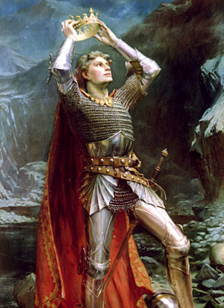
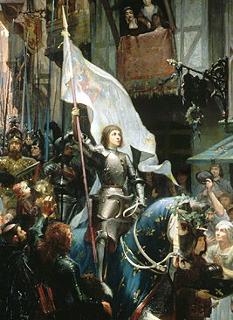
Beowulf Literary Focus: The Epic Hero
Beowulf is one of ancient England’s heroes.
Other times and other cultures have had other heroes….
King Arthur
Joan of Arc

Slide 28
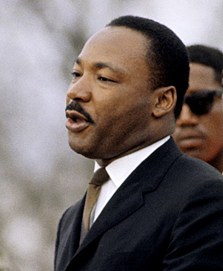
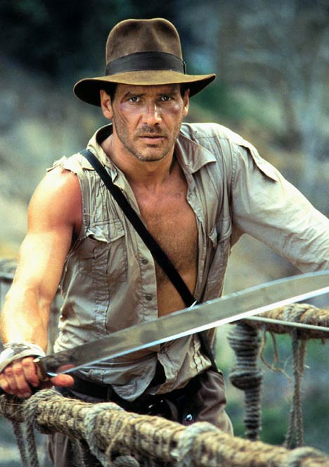
Beowulf Literary Focus: The Epic Hero
In modern America, the hero may be a real person or a fictional character….

Slide 29
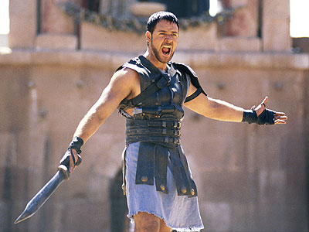
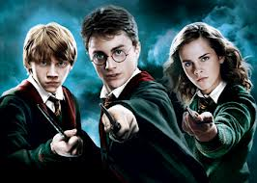
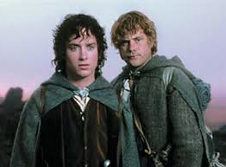
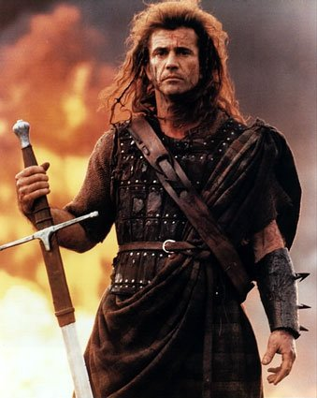
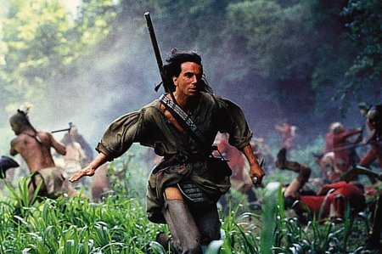
“Craig’s List” Top Picks…

Slide 30
Characteristics of an Epic Poem
Hero is a great leader
The setting is broad and includes supernatural realms
The hero does great deeds in battle or undertakes an extraordinary journey or quest…

Slide 31
Old English Poetics
Alliteration – repetition of consonant and vowel sounds at the beginning of words
Caesura – a natural pause or break in the middle of the line of poetry and joined by the use of a repeated vowel or consonant sound
Out of the marsh // from the foot of misty
Hills and bogs // bearing God’s hatred
Grendel came // hoping to kill
Anyone he could trap // on this trip to high Herot

Slide 32
Old English Poetics
Kennings – a metaphorical phrase used to replace a concrete noun. Ready made descriptive compound words that evoke vivid images
Kennings are formed by
prepositional phrases
possessive phrases
compound words
Preposition phrase – Giver of knowledge
Possessive phrase – mankind’s enemy
Compound word – sea path

Slide 33
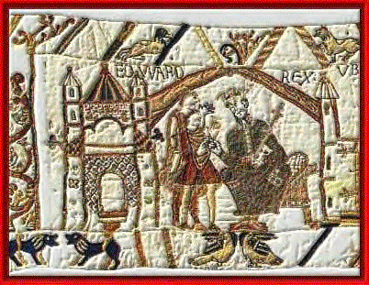
Some terms you’ll want to know
scop
A bard or story-teller.
The scop was responsible for praising deeds of past heroes, for recording history, and for providing entertainment

Slide 34
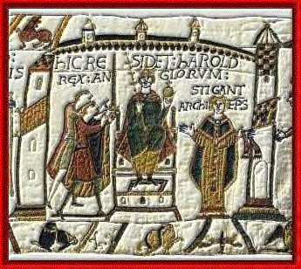
Some terms you’ll want to know
thane
A warrior
mead-hall
The large hall where the lord and his warriors slept, ate, held ceremonies, etc.

Slide 35
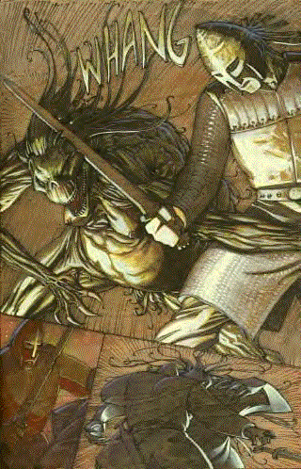
Some terms you’ll want to know
wyrd
Fate. This idea crops up a lot in the poem, while at the same time there are Christian references to God’s will.

Slide 36
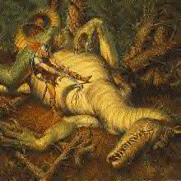
Some terms you’ll want to know
epic
Beowulf is an epic poem.
This means it has a larger-than life hero and the conflict is of universal importance. There’s a certain serious that accompanies most epics.

Slide 37
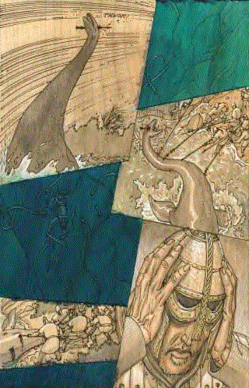
Some terms you’ll want to know
elegy
An elegy is a poem that is sad or mournful. The adjective is elegiac.

Slide 38
Themes and Important Aspects
Good vs. Evil
Religion: Christian and Pagan influences
The importance of wealth and treasure
The importance of the sea and sailing
The sanctity of the home
Fate
Loyalty and allegiance
Heroism and heroic deeds

